Slide 2
Objectives Overview
Identify the general categories of programs and apps
Describe how an operating system interacts with applications and hardware
Differentiate among the ways you can acquire programs and apps
Identify key features of productivity applications
Identify the key features of graphics and multimedia applications
See Page 158
for Detailed Objectives

Slide 3
Objectives Overview
Identify the uses of personal interest applications
Identify the purpose of software used in communications
Identify the key features of security tools
Identify the key features of file, disk, and system management tools
See Page 158
for Detailed Objectives

Slide 4
Programs and Apps
A program, or software, consists of a series of related instructions, organized for a common purpose, that tells the computer what tasks to perform and how to perform them
An application, or app, sometimes called application software, consists of programs designed to make users more productive and/or assist them with personal tasks
An operating system is a set of programs that coordinates all the activities among computer or mobile device hardware
Tools and activities
System software
Page 158

Slide 5
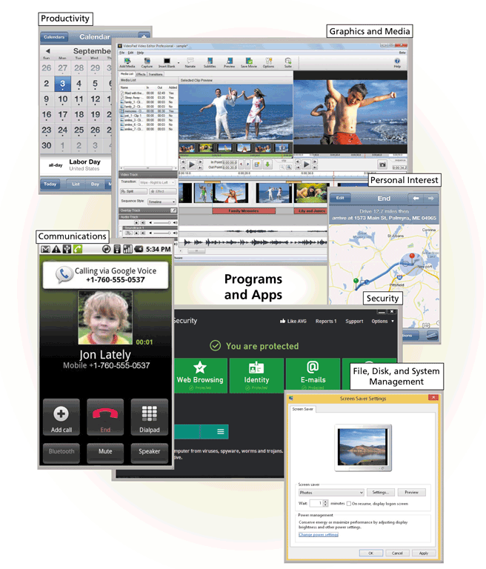
Programs and Apps
Page 159
Figure 4-1

Slide 6
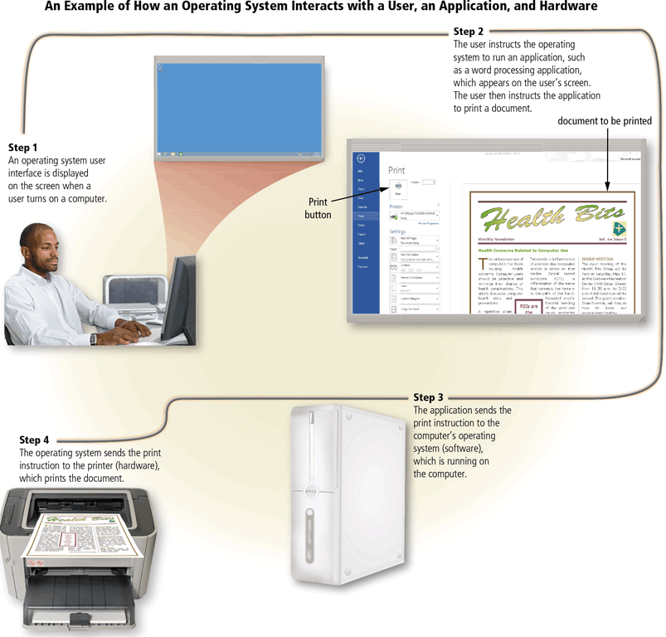
Programs and Apps
Page 160
Figure 4-2

Slide 7
Programs and Apps
Software is available in a variety of forms:
Retail
Shareware
Custom
Web app
Mobile app
Mobile web app
Freeware
Public domain
Open source
Page 161

Slide 8
Productivity Applications
Productivity applications can assist you in becoming more effective and efficient while performing daily activities at work, school, and home
Word processing
Presentation
Spreadsheet
Database
Note taking
Calendar and contact management
Project management
Accounting
Personal finance
Legal
Tax preparation
Document management
Enterprise computing
Page 165

Slide 9
Productivity Applications
With productivity applications, users often:
Create a project
Edit a project
Format a project
Save a project
Distribute a project
Pages 165 - 166

Slide 10
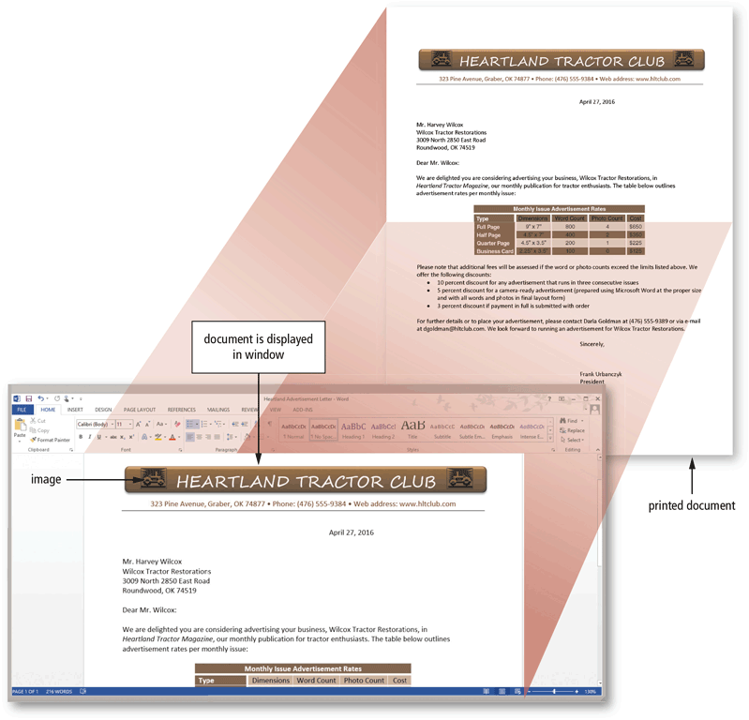
Productivity Applications
Word processing software allows users to create and manipulate documents
A major advantage of using word processing software is that it enables users to change their written words easily
Page 167
Figure 4-5

Slide 11

Productivity Applications
Presentation software allows users to create visual aids for presentations to communicate ideas, messages, and other information to a group
Page 168
Figure 4-6

Slide 12
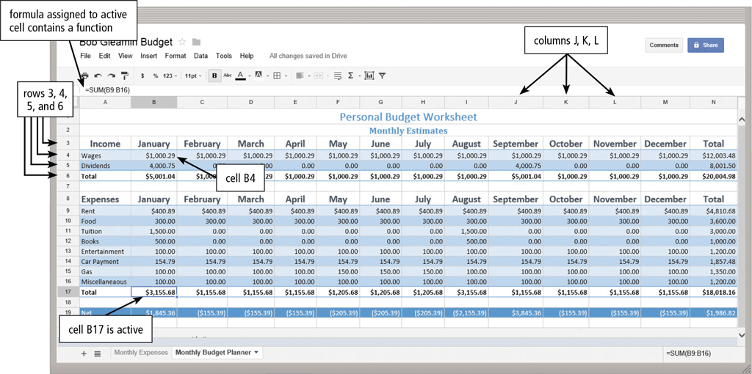
Productivity Applications
Spreadsheet software allows users to organize data in columns and rows and perform calculations on the data
Pages 168 - 169
Figure 4-7

Slide 13
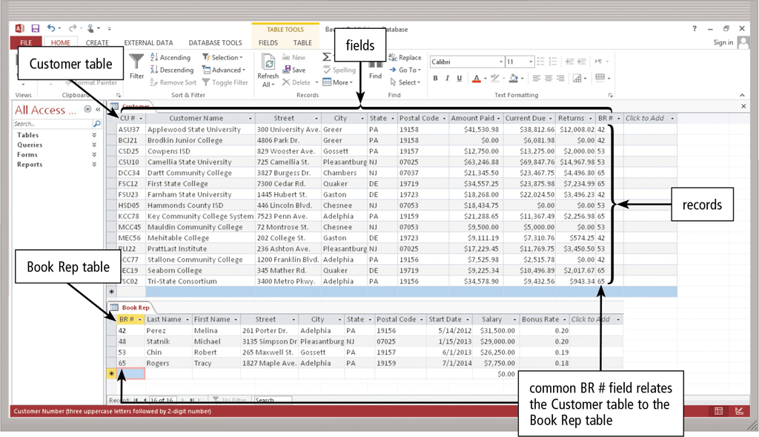
Productivity Applications
A database is a collection of data organized in a manner that allows access, retrieval, and use of that data
Database software allows users to create, access, and manage a database
Page 170
Figure 4-8

Slide 14
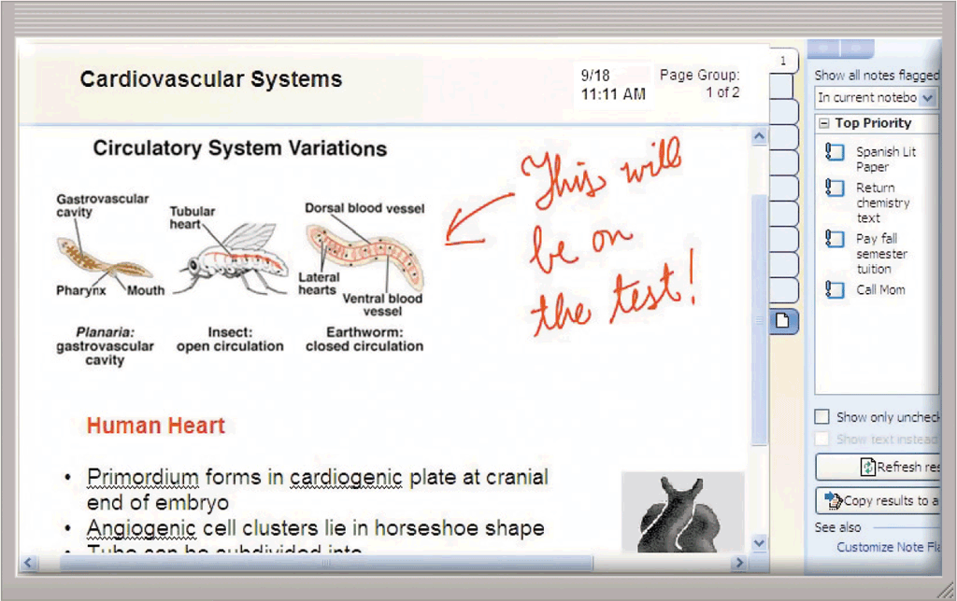
Productivity Applications
Note taking software is an application that enables users to enter typed text, handwritten comments, drawings, sketches, photos, and links anywhere on a page
Page 171
Figure 4-9

Slide 15
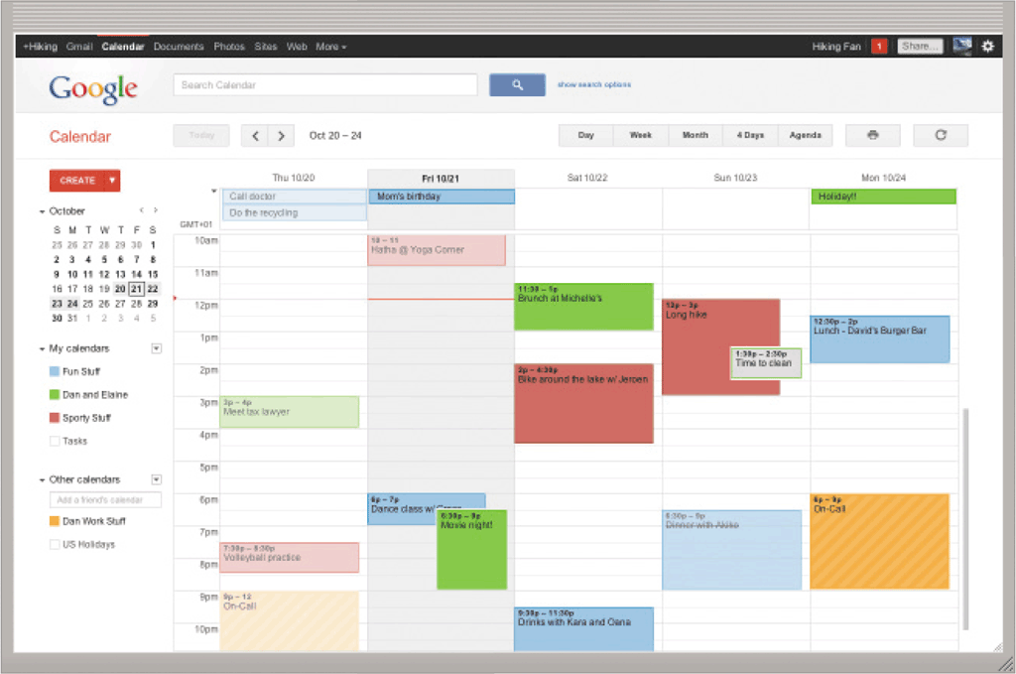
Productivity Applications
Calendar and contact management software is an application that helps you organize your calendar, keep track of contacts, and share this information with other users
Page 171
Figure 4-10

Slide 16
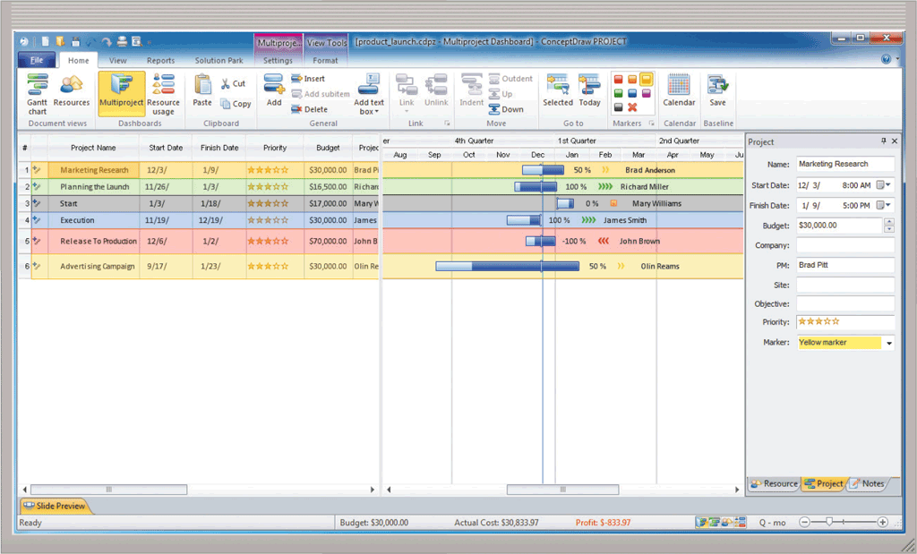
Productivity Applications
A software suite is a collection of individual related applications available together as a unit
Project management software is an application that allows a user to plan, schedule, track, and analyze the events, resources, and costs of a project
Page 172
Figure 4-11

Slide 17
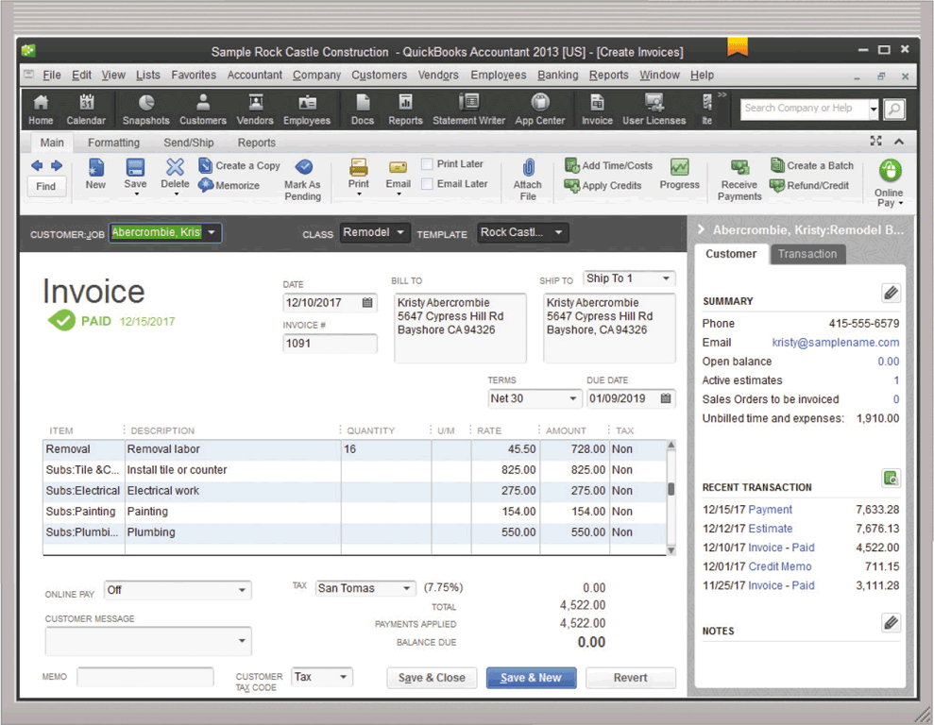
Productivity Applications
Accounting software is an application that helps businesses of all sizes record and report their financial transactions
Page 173
Figure 4-12

Slide 18
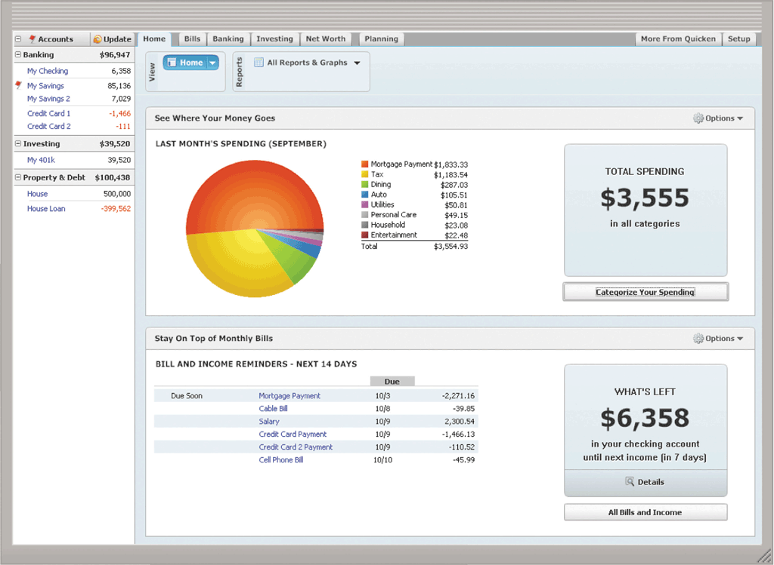
Productivity Applications
Personal finance software is a simplified accounting application that helps home users and small/home office users balance their checkbooks, pay bills, track personal income and expenses, verify account balances, transfer funds, track investments, and evaluate financial plans
Page 174
Figure 4-13

Slide 19
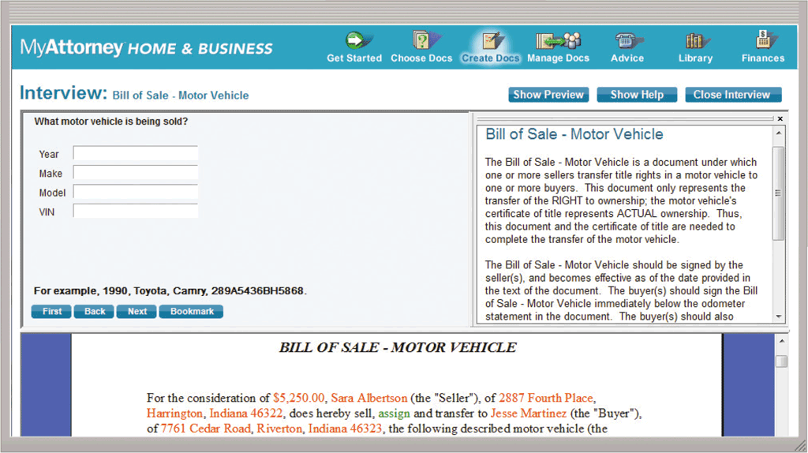
Productivity Applications
Legal software is an application that assists in the preparation of legal documents and provides legal information to individuals, families, and small businesses
Page 175
Figure 4-14

Slide 20
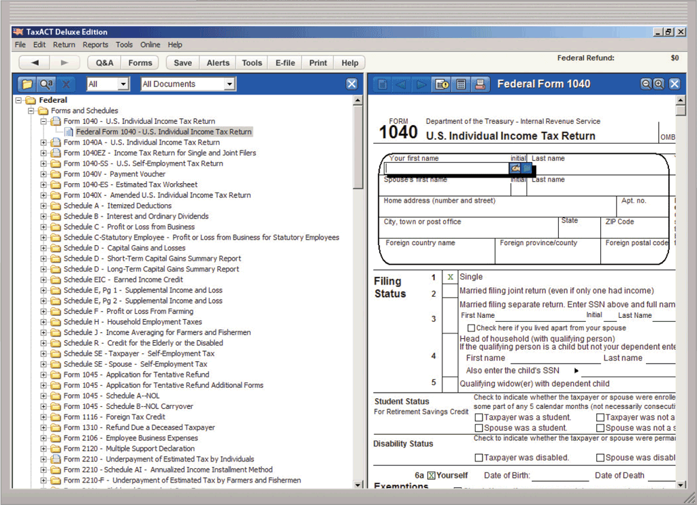
Productivity Applications
Tax preparation software is an application that can guide individuals, families, or small businesses through the process of filing federal and state taxes
Page 176
Figure 4-15

Slide 21
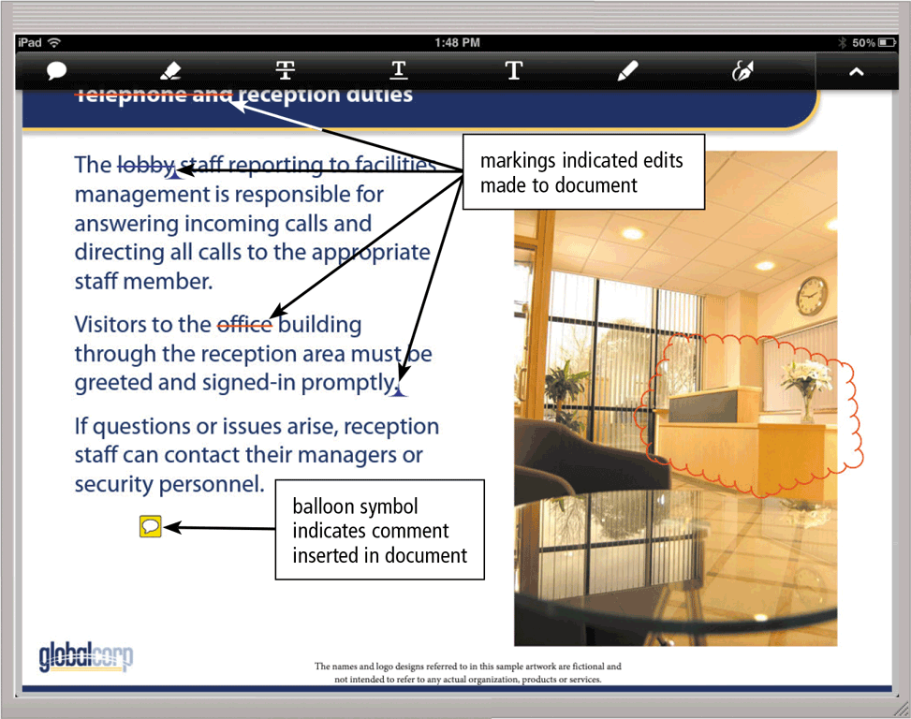
Productivity Applications
Document management software is an application that provides a means for sharing, distributing, and searching through documents by converting them into a format that can be viewed by any user
Page 176
Figure 4-16

Slide 22
Productivity Applications
A large organization, commonly referred to as an enterprise, requires special computing solutions because of its size and geographic distribution
Human resources software
Accounting software
Engineering or product development software
Manufacturing software
Marketing software
Sales software
Distribution software
Customer service software
Software for information technology staff
Page 177

Slide 23
Graphics and Media Software
Computer-aided design (CAD) software
Desktop publishing software
Paint/Image editing software
Pages 180 – 181
Figures 4-17 – 4-19

Slide 24
Graphics and Media Software
Photo editing and photo management software
Video and audio editing software
Pages 181 – 183
Figures 4-20 – 4-21

Slide 25
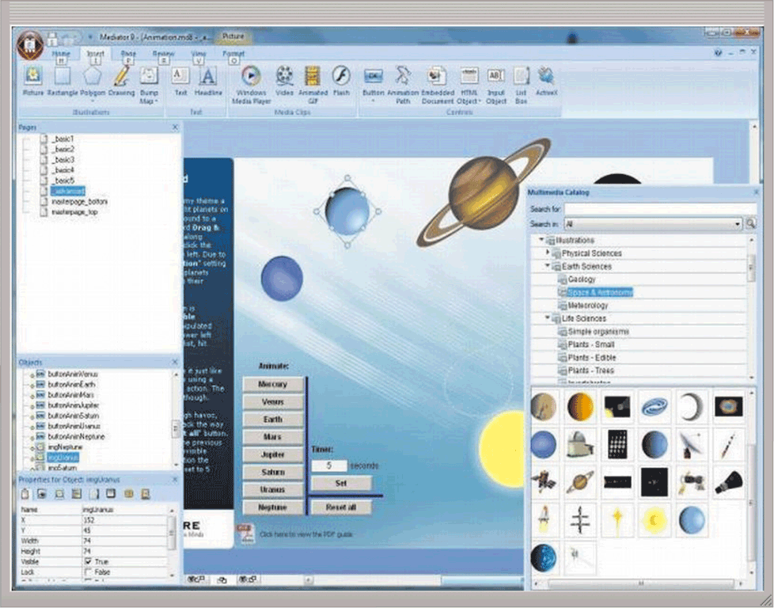
Graphics and Media Software
Multimedia authoring software allows users to combine text, graphics, audio, video, and animation in an interactive application
Website authoring software helps users of all skill levels create webpages that include graphics, video, audio, animation, and special effects with interactive content
Page 184
Figure 4-22

Slide 26
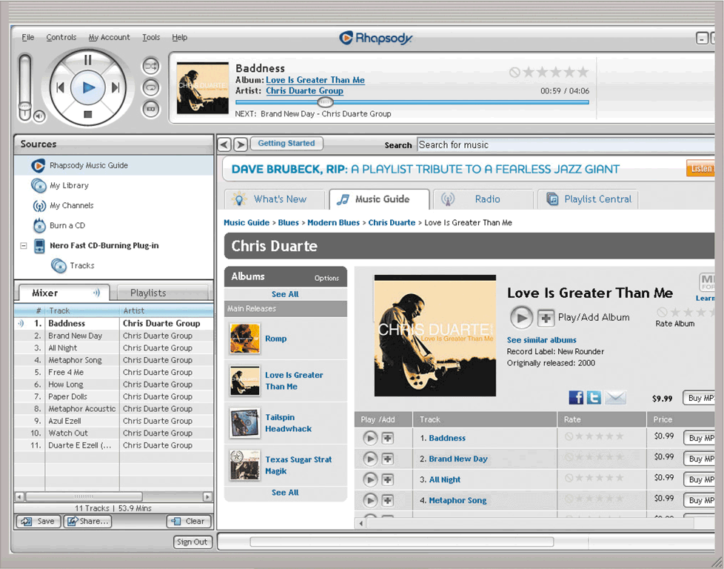
Graphics and Media Software
A media player is a program that allows you to view images and animations, listen to audio, and watch video files on your computer or mobile device
Disc burning software writes text, graphics, audio, and video files on a recordable or rewritable disc
Page 185
Figure 4-23

Slide 27
Personal Interest Applications
Lifestyle applications
Medical applications
Entertainment applications
Convenience applications
Education applications
Pages 185 - 186

Slide 28
Communications Applications
Blog
Browsing
Chat
Online Discussion
Email
File Transfer
Internet Phone
Instant Messaging
Mobile Messaging
Videoconference
Web Feeds
Page 188

Slide 29
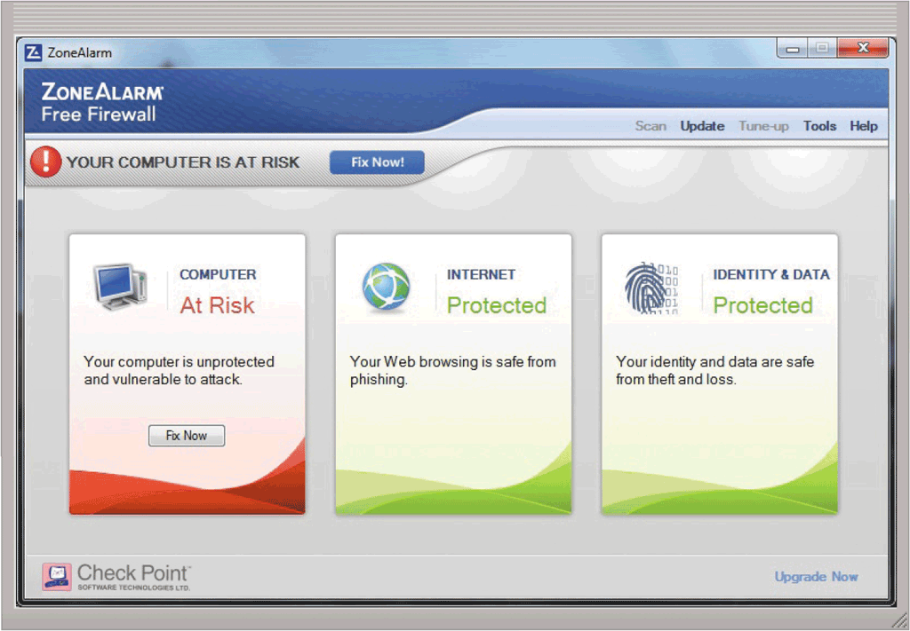
Security Tools
A personal firewall is a security tool that detects and protects a personal computer and its data from unauthorized intrusions
Page 189
Figure 4-24

Slide 30
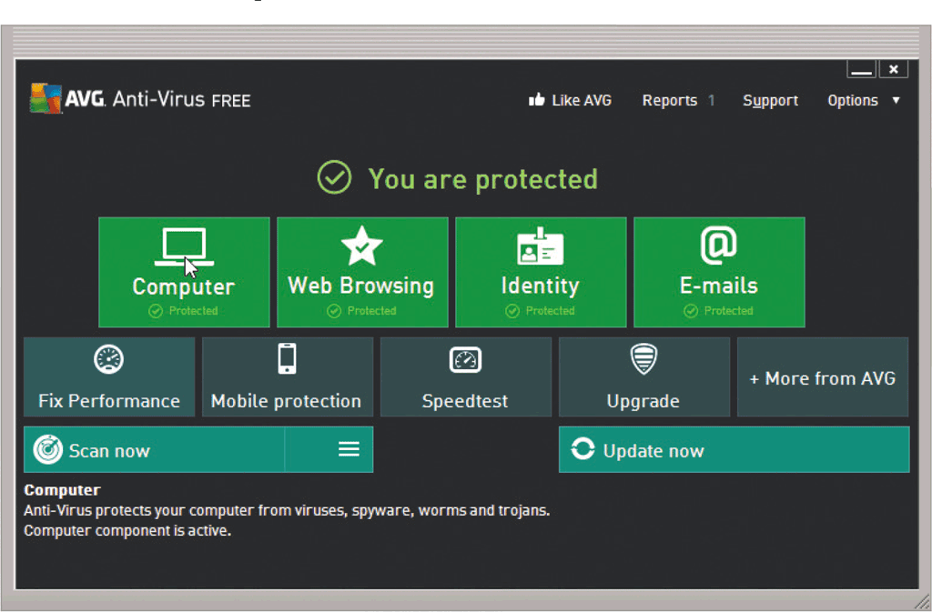
Security Tools
An antivirus program protects a computer against viruses by identifying and removing any computer viruses found in memory, on storage media, or on incoming files
Page 191
Figure 4-25

Slide 31
Security Tools
Spyware is a type of program placed on a computer or mobile device without the user’s knowledge that secretly collects information about the user and then communicates the information it collects to some outside source while the user is online
Adware is a type of program that displays an online advertisement in a banner or pop-up or pop-under window on webpages, email messages, or other Internet services
Page 192

Slide 32
Security Tools
A spyware remover is a type of program that detects and deletes spyware and similar programs
An adware remover is a program that detects and deletes adware
Page 192

Slide 33
Security Tools
Anti-spam programs
Web filtering software
Phishing filters
Pop-up and pop-under blockers
Pages 193 - 194

Slide 34
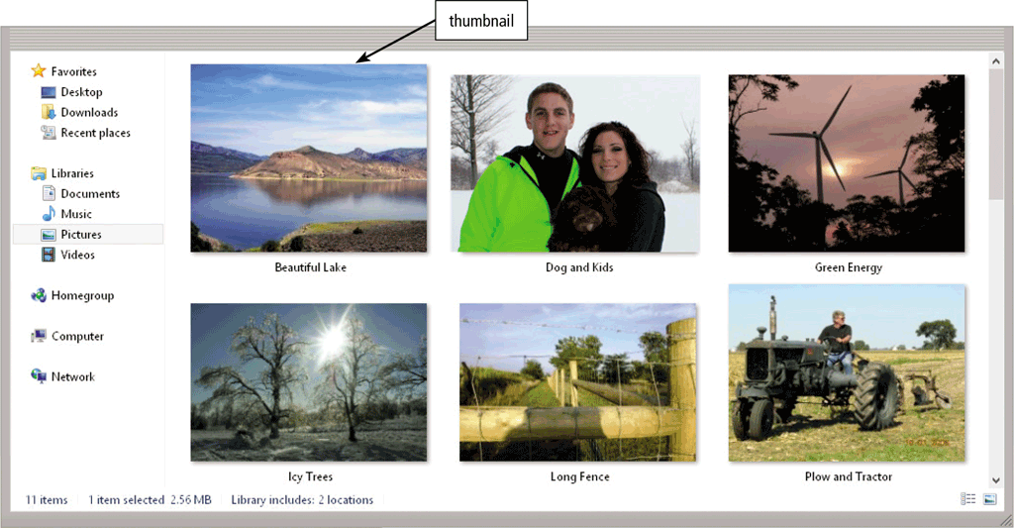
File, Disk, and System Management Tools
A file manager is a tool that performs functions related to file management
Page 194
Figure 4-27

Slide 35
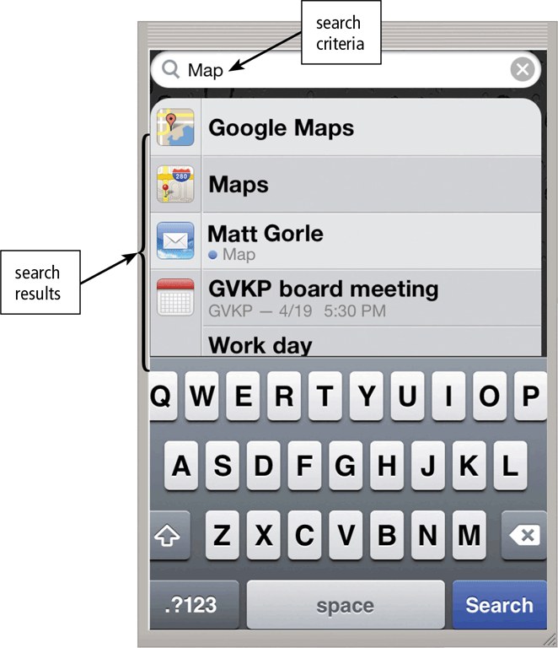
File, Disk, and System Management Tools
A search tool is a program, usually included with an operating system, that attempts to locate a file, contact, calendar event, app, or any other item stored on your computer or mobile device based on criteria you specify
Page 195
Figure 4-28

Slide 36
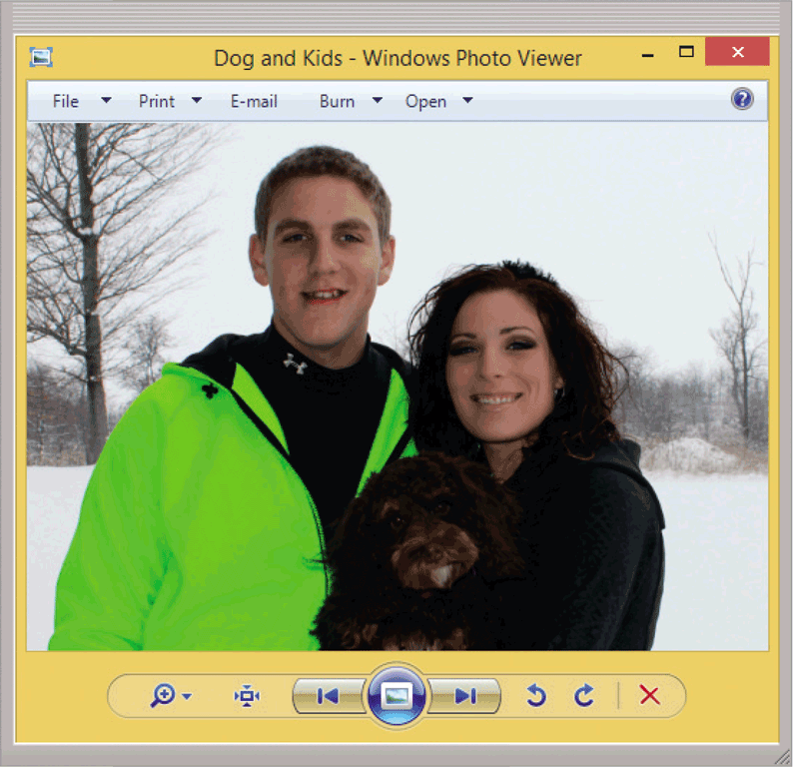
File, Disk, and System Management Tools
An image viewer is a tool that allows users to display, copy, and print the contents of a graphics file, such as a photo
An uninstaller is a tool that removes a program, as well as any associated entries in the system files
Page 195
Figure 4-29

Slide 37
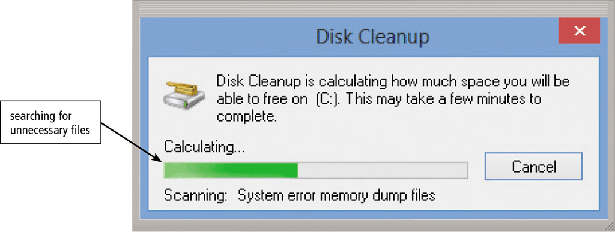
File, Disk, and System Management Tools
A disk cleanup tool searches for and removes unnecessary files
Page 196
Figure 4-30

Slide 38
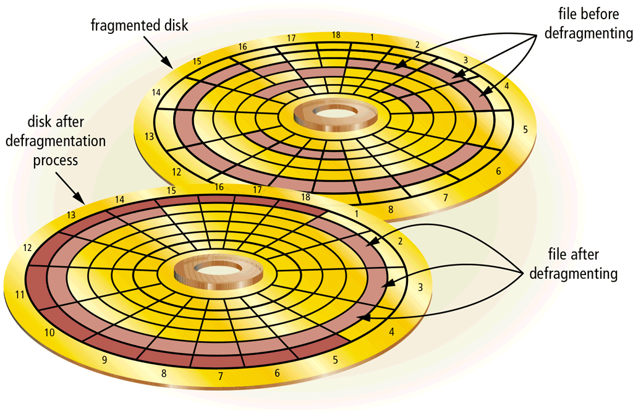
File, Disk, and System Management Tools
A disk defragmenter is a tool that reorganizes the files and unused space on a computer’s hard disk so that the operating system accesses data more quickly and programs run faster
Defragmenting
Page 197
Figure 4-31

Slide 39
File, Disk, and System Management Tools
A screen saver is a tool that causes a display device’s screen to show a moving image or blank screen if no keyboard or mouse activity occurs for a specified time
A file compression tool shrinks the size of a file(s)
A PC maintenance tool is a program that identifies and fixes operating system problems, detects and repairs drive problems, and includes the capability of improving a computer’s performance
Pages 197 - 198

Slide 40
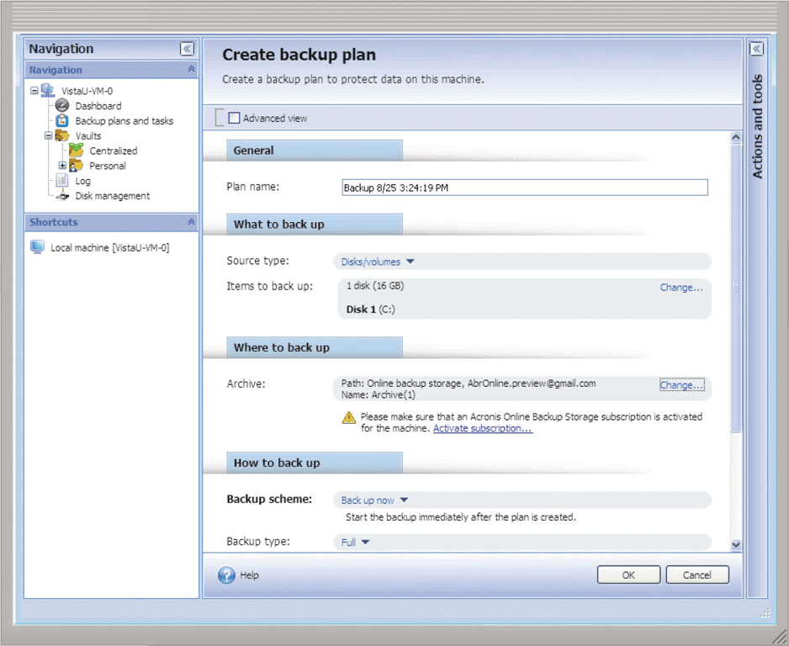
File, Disk, and System Management Tools
A backup tool allows users to copy, or back up, selected files or the contents of an entire storage medium to another storage location
A restore tool reverses the process and returns backed up files to their original form
Page 198
Figure 4-32

Slide 41
Summary
Programs and apps available for computers and mobile devices
Role of the operating system and the various ways software is distributed
Features of a variety of applications
Communications applications
Security tools and file, disk, and system management tools
Page 199

Slide 42
Chapter 4 Complete

